Slide 1
TESLA STOCK
BY MIRNA PHILIP

Slide 2

BACKGROUND OF TESLA
Tesla is an automotive company founded in 2003 that specializes in electric cars and energy storage.
Tesla is known for taking more risks than other companies.
Tesla's stock price, TSLA, has been a hot topic this year due to predictions that it will reach $200 by the end of 2023.
Notes:
Tesla is an automotive company founded in 2003 that specializes in electric cars and energy storage. Known for taking more risks than other companies, Tesla's stock price, TSLA, has been a hot topic this year due to predictions that it will reach $200 by the end of 2023. Despite fluctuating over the years, the stock price has risen significantly since Tesla introduced the Model S in 2011. Recently, the price dropped due to a racial discrimination lawsuit, but it has since stabilized and is currently low, providing an opportunity for customers to invest in TSLA shares. Overall, there is a good probability that the stock price will rise once more.

Slide 3
The area problem…
Company
Problem
solution
Tesla Stock
Tesla's stock price can go up or down depending on how many cars they make and sell, how much competition they have, and what's happening in the global economy.
Tesla can improve by better managing supplies, production, and logistics, innovating through research and development, expanding market share, offering more services, and adapting to changing economic conditions.

Slide 4
GOAL:
The primary goal in this project is to analyze the data and perform Predictive Modeling to predict the price of Tesla stock, but there will be other data mining techniques such as Market Sentiment Analysis and Risk Management to gain a more comprehensive understanding of the stock and its potential future performance.

Slide 5
the problem:
Tesla faces intense competition in the electric vehicle market, which can lead to price wars and lower profits, negatively impacting the company's financial performance and stock price. As a publicly listed business, Tesla's stock price is subject to changes based on fluctuations in the overall market and investor sentiment. Additionally, the company has a history of losing money and relying heavily on debt to support its operations, posing a financial risk.
Solution:
The price of Tesla products should be balanced between affordability for consumers and profitability for the company. To be successful, Tesla should also invest in marketing and promotion to increase brand awareness, diversify its investments to minimize the impact of price fluctuations, and implement clear risk management policies.

Slide 6
Solution Marketing and Promotions: Boosts visibility and reputation, attracts and retains customers, creates competitive advantage.
Solution Diversification: Reduces dependence on one area, spreads risk for stability and resilience.
Solution Risk Management Policies: Helps identify, assess, and manage potential risks for stability.
Impact of the solutions:

Slide 7
Inventory of resources
Personnel Sources
Data Source
Software | Hardware
Personnel Sources:
Project manager, data scientist and a business expert
Data Source:
collected this data from user Aman Chuhan on Kaggle (2022). There was a single 63 kB CSV file with data from 2010 to 2022. Data file include:
Seven columns
which are the date, open, high, low, and close and Adj Close and volume
Software Source:
Software :Python
Hardware Source:
hardware: MacBook Air

Slide 8
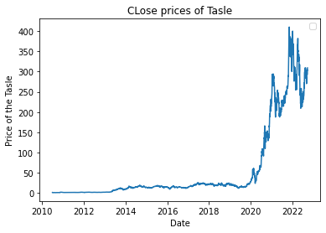
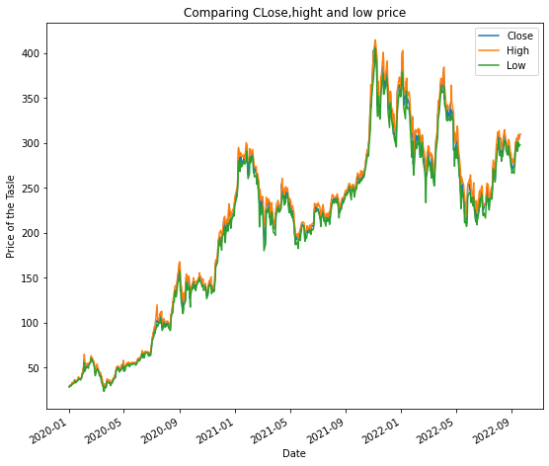
Result:
The data and statistics of Tesla stock suggest that as the stock market increases, the number of investors also increases. The study hypothesized that higher closing prices lead to more stock investors in Tesla. Figure 2 showed that in 2020, Tesla stock prices rose and more shares were sold, but prices declined at the end of 2021, which is unexplained. Figure 3 indicated minimal difference between the close, high, and low prices, suggesting stability. The study provides evidence supporting the hypothesis, but further research may be needed to understand factors impacting Tesla stock prices.
Figure 2:
Figure 3:

Slide 9
Accuray
86%

Slide 10
Business Objective & Success Criteria
Revenue Growth
Earning Per Share
Market Share
With increased manufacturing and sales of its electric vehicles, Tesla has seen a sharp increase in revenue the currently the revenue is $15.2 billion
With a positive earnings per share of $1.68 for the quarter., Tesla has been continuously profitable in recent years.
With a strong market share, Tesla dominates the electric vehicle industry.

Slide 11
Data Science Glossary
Python
Exploratory Data Analysis
Predictive Modeling
Data cleaning
Data Visualization
Linear Regression
Forecasting

Slide 12
Estimate the cost of the Project
Needed:
Data scientist
Project management
MacBook Air
Other necessary items
Estimate:
Data scientist: $10,000
Project management: $15,000
MacBook Air: $1,000
Other necessary items: $5,000
The estimate cost of this project is $31,000 united state dollars

Slide 13
Understand Business:
Background
Inventory sources
Business risks
Requirements
Data Preparation:
Data Collecting
Data Cleaning
Apply ML
Data visualization
Presentation:
Create google slide
Record video of the presentation
Present it to Stakeholders
Week 1 & 2
Week 3 & 4
Week 5
Week 6
Week 7
Data Understanding:
Collecting data
Data Exploration
Data Quality
Report Preparation:
Gantt Chart
Editing the report
Adding Additional information

Slide 14
References
Cadie Thompson, K. L. (n.d.). Tesla just celebrated its 12th year as a public company. Here are the most important moments in its history. Business Insider. Retrieved February 20,2023, from https://www.businessinsider.com/most-important-moments-tesla-history-2017-2#july-2003-tesla-motors-is-founded-by-a-group-of-silicon-valley-engineers-1
Contributor, B. G. (2022, October 18). Tesla History Timeline: Evolution & Stock prices. CleanTechnica. Retrieved February 20, 2023, from https://cleantechnica.com/2022/10/18/tesla-history-timeline-evolution-stock-prices/
Tesla. (n.d.). Elon Musk. Retrieved from https://www.tesla.com/elon-musk.

